Slide 1
WOONG JIN LOGISTICS LTD
Air & Sea Logistics

Slide 2
1
WJ LOGISTICS
INTRODUCTION

Slide 3
ORGANIZATION CHART
CONSULTING TEAM
A
INTERNATIONAL SHIPPING TEAM
B
C
WAREHOUSE TEAM
D
CUSTOMS AGENT
E
SHIPPING MANAGEMENT TEAM

Slide 4
NETWORK
EUROPE / MIDDLE EAST
NORTH AMERICA
ASIA / PACIFIC
AFRICA
CENTRAL / SOUTH AMERICA
WORK WITH PARTNERS WOLDWIDE.

Slide 5
TOTAL LOGISTICS SOLUTION
OPERATOR
Accurate work
SERVICE
Until the customer is satisfied
LIVE
Real- time business processes
ING
Follow-up management to the end
TIME
Efficient processing in the shortest time
UNDERSTAND
Creative business with high understanding
OASIS
Become an oasis for a partner with faith and trust
POSITIVE
Performing a positive work instead of negative thinking

Slide 6
TOTAL LOGISTICS SOLUTION
Service
Time
We secure relevant information and data according to the flow of logistics, and provide smooth and optimized logistics services by grafting them into work.
By establishing SOP , we provide the best service and maximize the efficiency in customer service.
Operator
Ing
Establish SOP for each company and work with customers organically to maximize efficiency.
Satisfy customer needs through follow-up management to ensure that no problem occurs until it is delivered to customer.
Live
Oasis
Minimizes the problem caused by delayed arrival and departure by securing information on cargo arrival and departure port in real time.
Due to its specialty, we provide stable logistics in the trust and trust of customers.
Understand
Positive
Provides improvement of work by grasping customer's discomfort and finding ways.
Responding positively to customers, dealing with customer problems in the shortest time.

Slide 7
2
WJ LOGISTICS
SERVICES AND ACTIVITIES

Slide 8
AIR CARGO
Woongjin Logistics is a specialized transport company, and we would like to be recognized as one of the strongest professional transport companies in Korea.
This reputation is based on your trust in the delivery service provided by experienced employees along with your accumulated export and import transportation performance.
With continuous service development, security and customer guidance, I promise to evolve into the world's leading multi-carrier of the 21st century.
Air Freight Dealership Service.
Cargo Handling, bonded warehouse
service.
Worldwide Shipping, Air Consolidated
Transportation .
Console and Logistics Movement.
Customs Service.
Trilateral transportation.

Slide 9
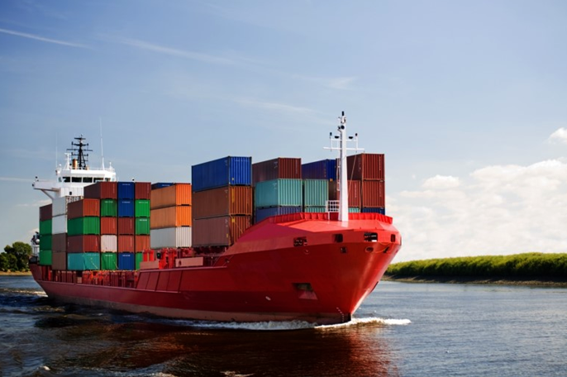
OCEAN CARGO
Based on the expertise of KNOW- HOW accumulated, the customer's trust and credit spirit, Woongjin Logistics is committed to meeting the diverse needs of its customers.
With a complete partnership with selected local companies in countries around the world, we are making utmost efforts to ensure that customers can receive high-quality total transportation services wherever they want.
We will take the lead in maximizing customer satisfaction by developing new services and reducing logistics costs.
International Shipping Freight
Forwarding Service.
Worldwide agent network.
FCL / LCL service at economical cost.
Oversized/Heavy/Project cargo.
Logistics services (Door To Door, Bonded
Warehouse Transaction, Cargo insurance)
Trilateral transportation.
Customs Service.

Slide 10
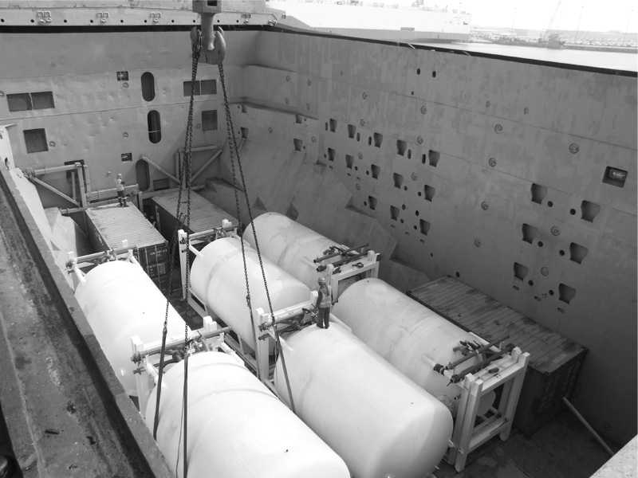
BULK & HEAVY CARGO
Woongjin Logistics provides differentiated services for bulk and heavy cargo based on its close relationship with shipping company's.
Based on many years of experience and ability, we find optimal transportation services for different types of cargo and provide specialized BULK & HEAVY CARGO services to meet the various needs of our customers.
Close cooperation system with the
shipping company.
Professional service for heavy cargo.
Worldwide agent network.
Oversized / Heavy / Project cargo.
Skilled Bulk Cargo Specialist.
Various kinds of bulk cargo handling
experience.

Slide 11
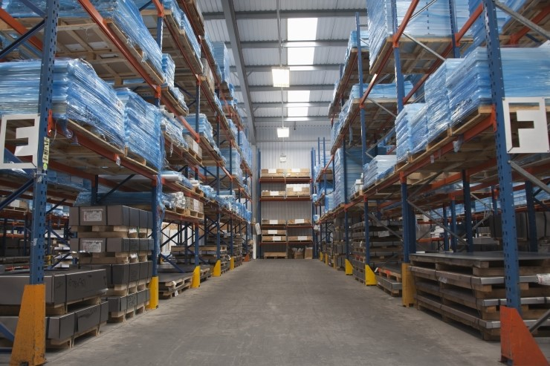
Bonded warehouse & Delivery Service.
Through the bonded warehouse service, we will provide logistics services such as customs clearance, storage, and bonded transportation to suit the customer's eye level.
The airport has large bonded warehouses and branches such as Seoul, Incheon International Airport, Incheon Port, Arabat Road, Busan, Busan New Port, Ulsan, Gwangju Metropolitan City, and Pyeongtaek, enabling the management (order, ship, pick up, delivery) of nationwide network services as smart apps.
One-stop management.
- Order, Ship, Pick-Up, Delivery.
Smart management through smart apps.
Warehouse Operation and Management.
bonded transportation service .
storage and segregation of export cargo.
storage and segregation of import cargo.

Slide 12
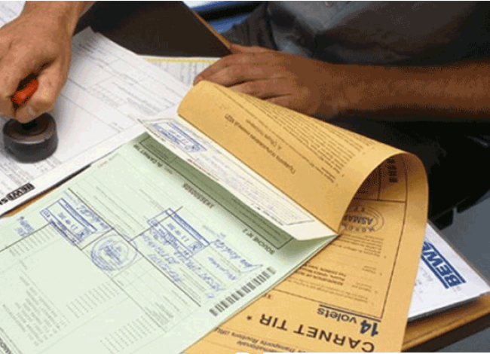
CUSTOMS AGENCY
Consisting of a customs attorney with 30 years' experience and excellent employees with at least five years' experience, Woongjin Customs has a history of more than 10 years.
This history has been accompanied by numerous experiences and business agreement with international forwarding.
Woongjin Customs Corporation provides customs service that combines various fields such as export & import customs clearance, ATA-carnet, Duty drawback, requirement approval, food & plant quarantine, etc.
Export/Import Customs Clearance, ATA-Carnet and Duty Drawback.
Application for customs requirements.
such as the Radio frequency regulation.
Food and Plant Quarantine.
FTA Consulting.
AEO Certification.

Slide 13
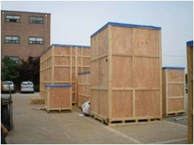
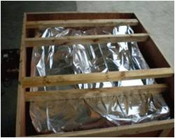
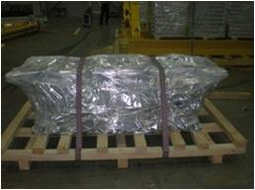
EXPORT PACKING SERVICE.
TEAM1 INCHEON
Gyeongin, Northern Gyeonggi
TEAM2 GYEONGGI, CHUNGCHEONG
Industrial Complex, Chungcheong,
Southern Gyeonggi
TEAM3 SEOUL
Seoul, Gangwon-do
TEAM4 GUMI
Gyeongsang-do, Jeolla-do
All business trips in the area
Providing appropriate packing service for each cargo for safe international transportation.
Packaging service for various cargoes based on know-how based on various experiences.

Slide 14
DOOR TO DOOR SERVICE
EX FACTORY
DEPARTURE
CLEARANCE
DELIVERY
CUSTOMER
Efficient management of cargo progress from EX Factory to customer
One-step service to customs and transportation reduces processing time
Reduction of logistics costs through innovation of cost structure
Reliable follow up management.

Slide 15
3
WJ LOGISTICS
CONTACT

Slide 16
WJ LOGISTIC CONTACT.
WOONGJIN LOGISTICS Co.,Ltd.
#712, 220, Gonghang-daero,
Gangseo-gu, Seoul, Republic of Korea
TEL 02-2662-7111
FAX 02-2662-7123
E-MAIL kykim@iwoongjin.co.kr
Homepage www.iwoongjin.co.kr

Slide 17
Thank You.

